Slide 1
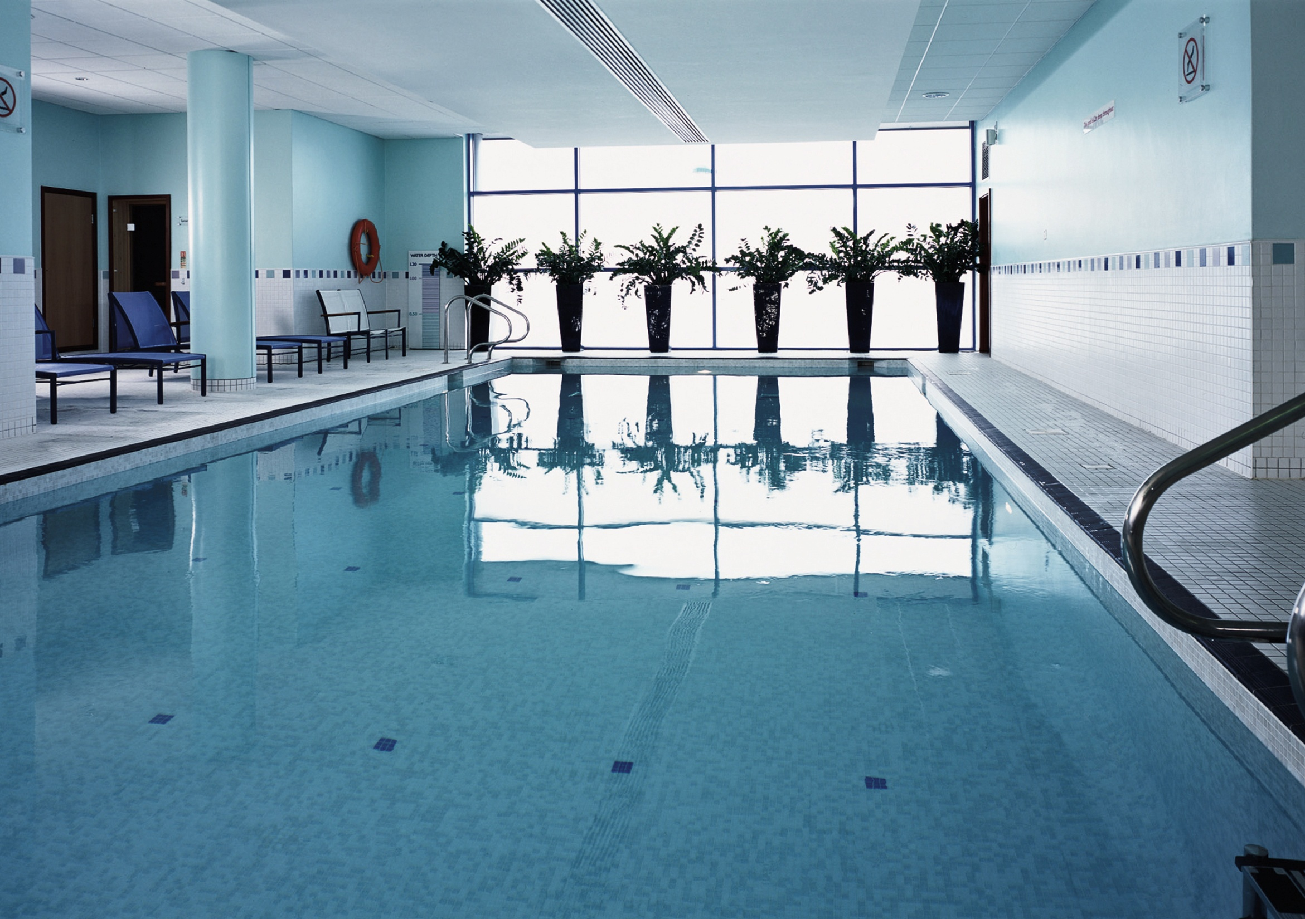

Slide 2
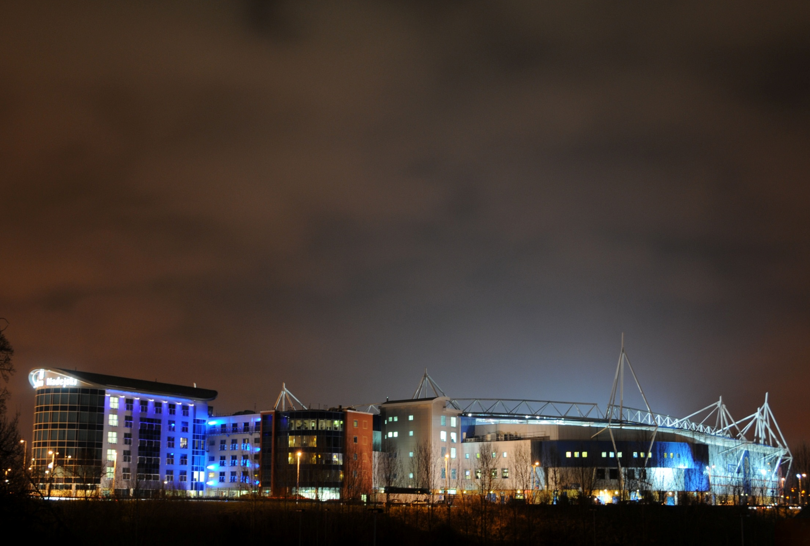
Millennium Madejski Hotel Reading
42 meeting rooms (including the Royal Berkshire Conference Centre)
32 pitch facing meeting rooms
Plasma screens in 39 meetings rooms
Free parking for over 1000 cars, coaches or articulated vehicles
Complimentary Wi-Fi throughout the complex for everyone
Frequent bus service to local business parks, town centre and rail station

Slide 3
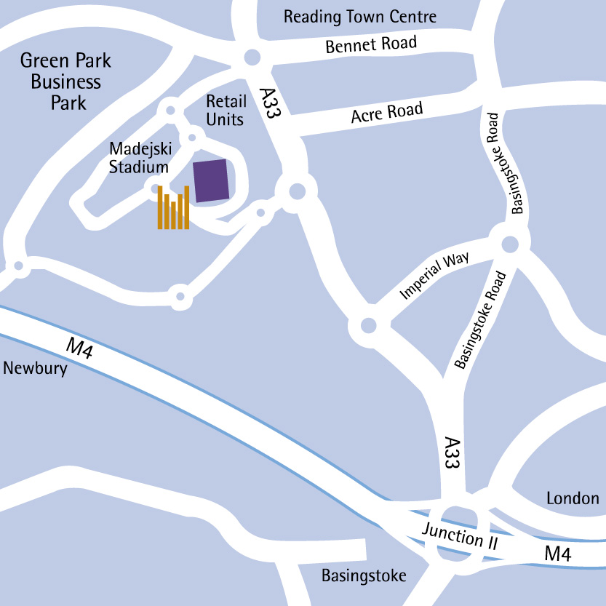
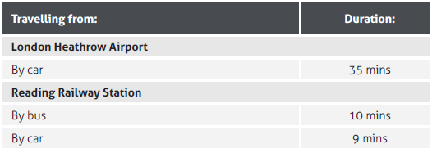
Millennium Madejski Hotel Reading
Ideally situated close to the M4 motorway
Part of the prestigious Madejski Stadium complex, home to Reading FC and London Irish RFC
The hotel offers modern amenities, excellent service and stylish guest rooms.
Green Park, Reading International Business Park, Arlington Business Park, Thames Valley Business Park and IQ at Winnersh are all within easy reach
Transportation Links

Slide 4
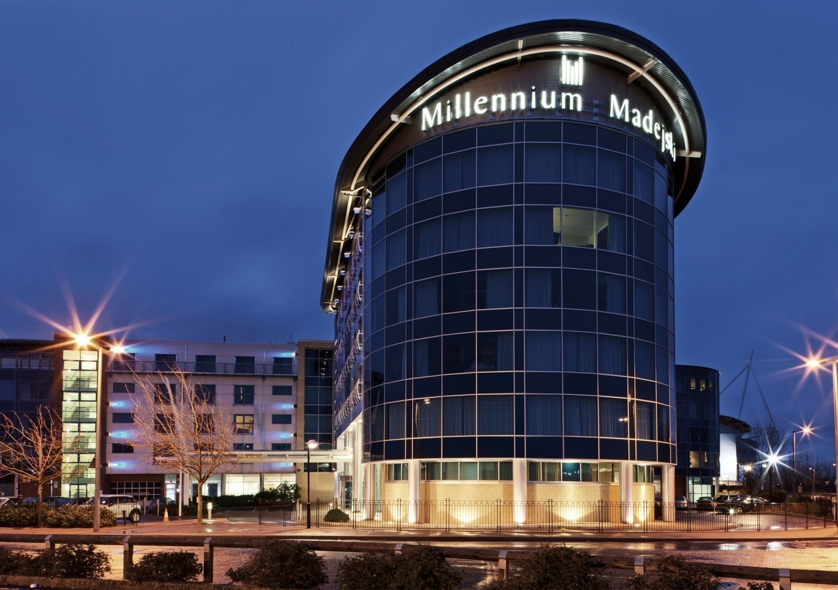
Millennium Madejski Hotel Reading

Slide 5
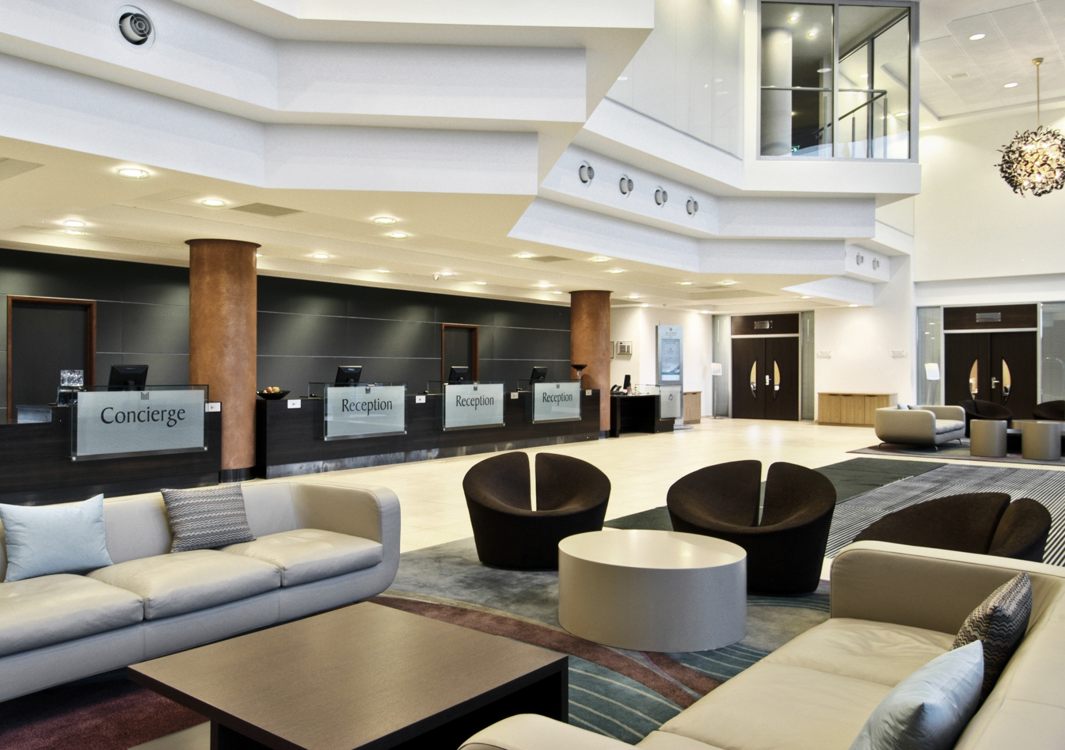
Millennium Madejski Hotel Reading
Lobby

Slide 6
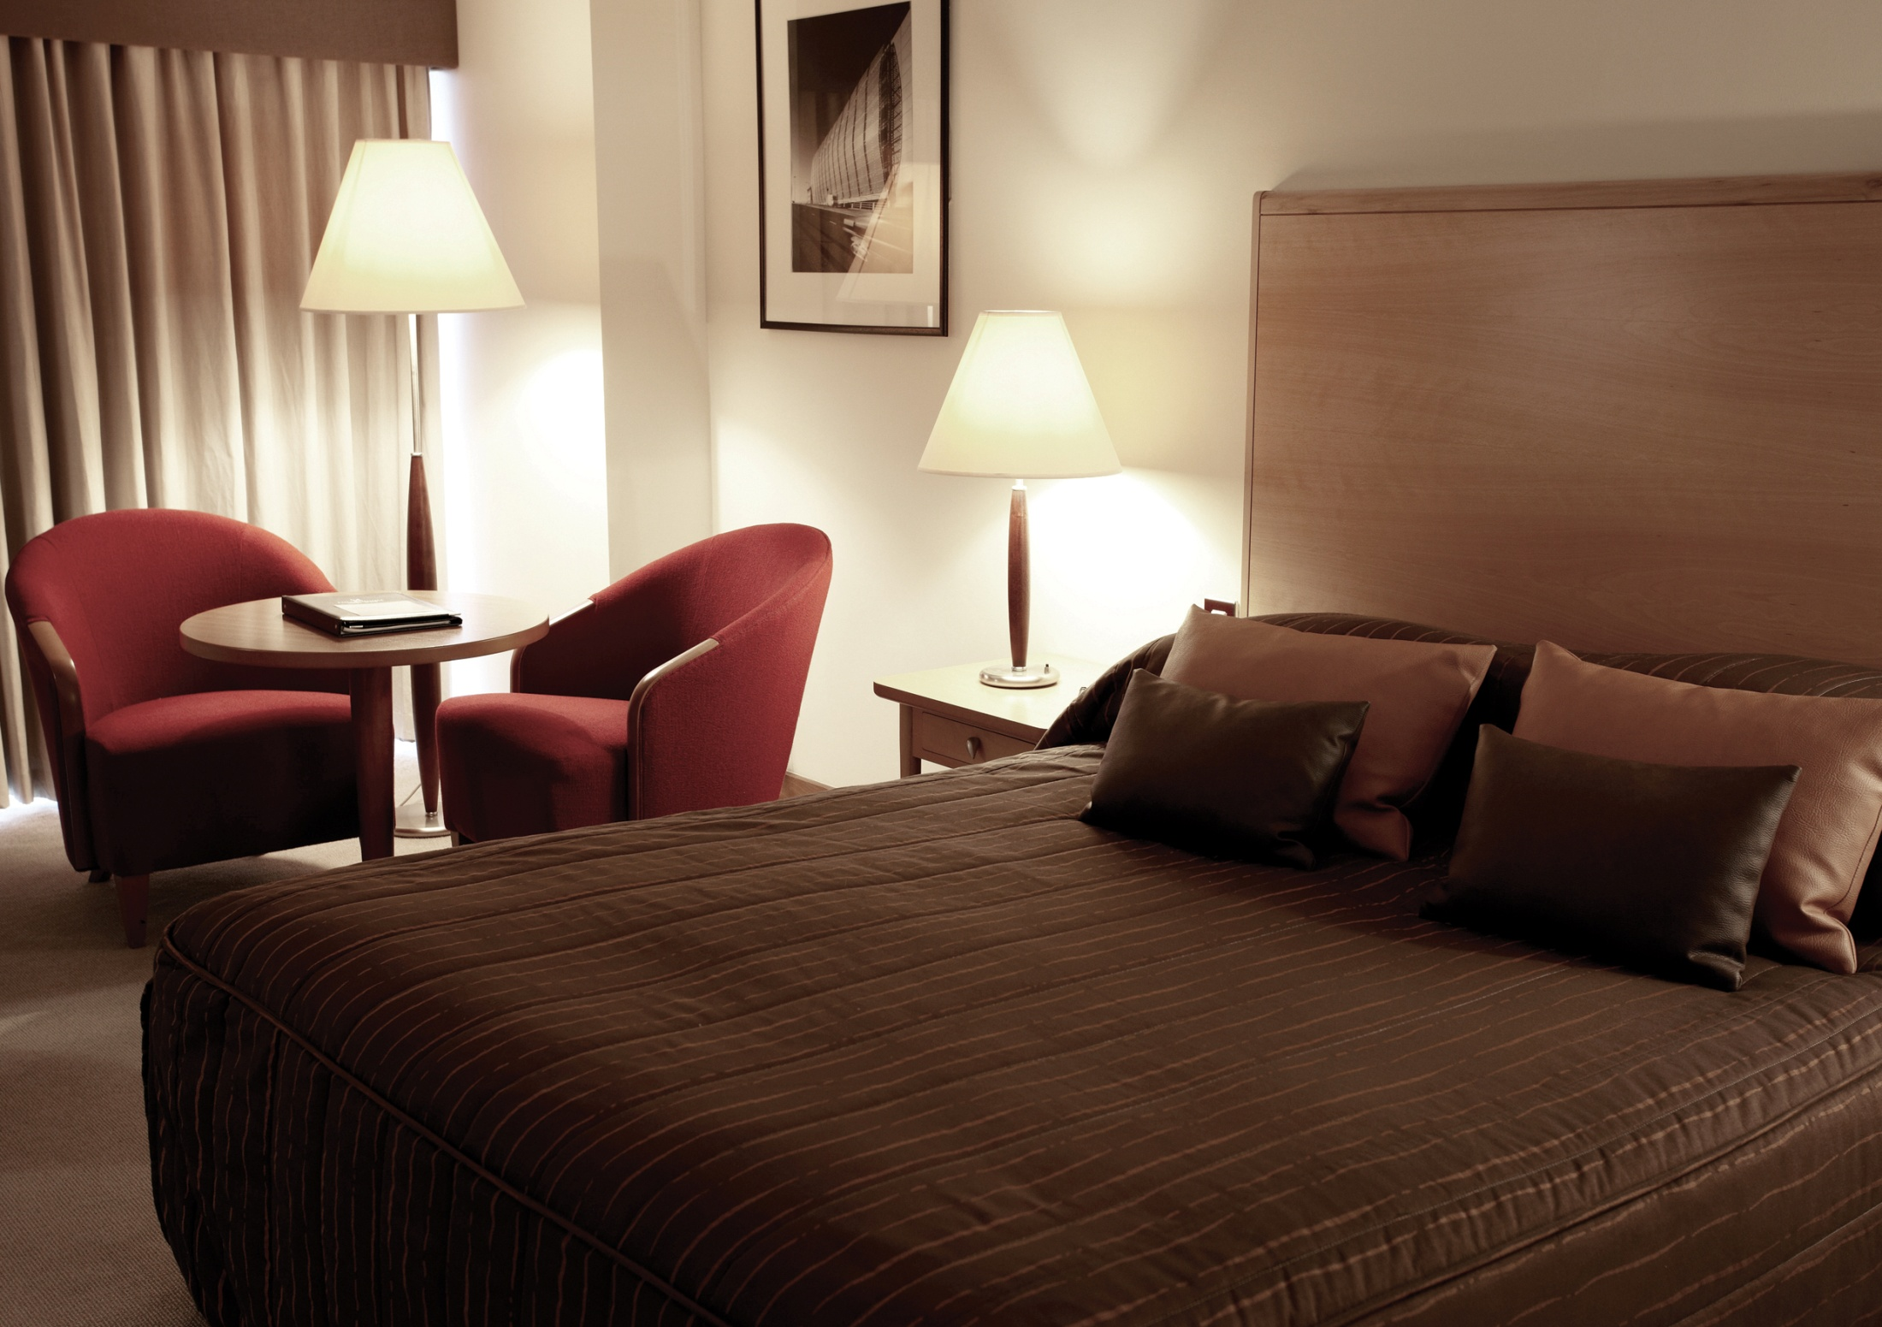
Millennium Madejski Hotel Reading | Accommodation
Accommodation
201 guest bedrooms
Standard, Family, Clubs and Suites
Amenities
Satellite TV including sports channels,
Wired high speed internet access and complimentary Wi-Fi
In-room safe
Trouser press, iron & ironing board
Standard Room

Slide 7
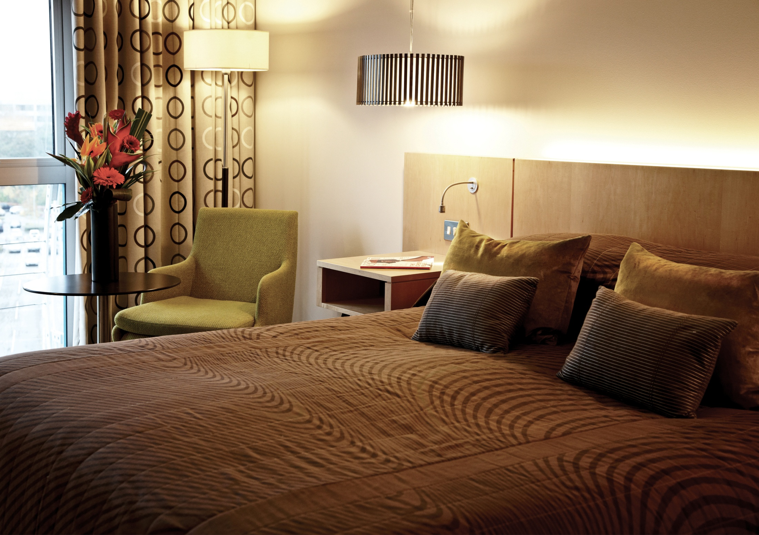
Millennium Madejski Hotel Reading
Club Room

Slide 8
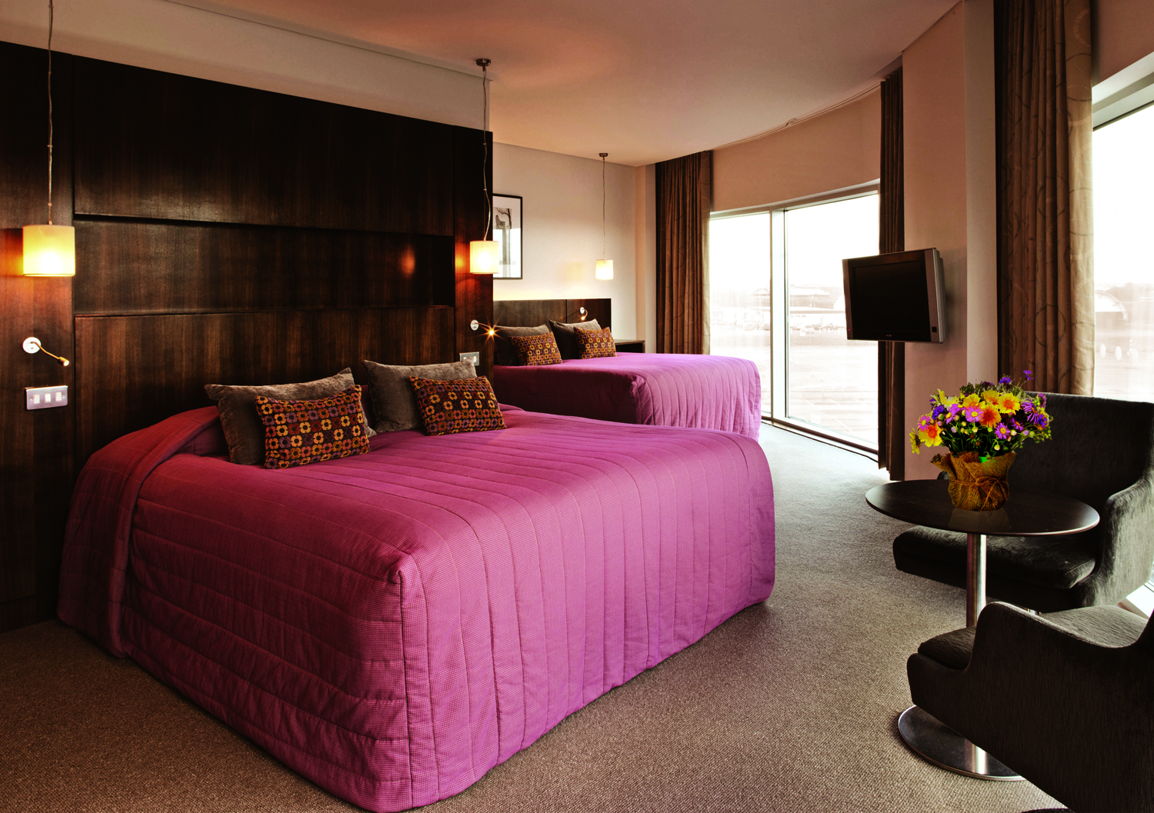
Millennium Madejski Hotel Reading
Corner Family Room

Slide 9
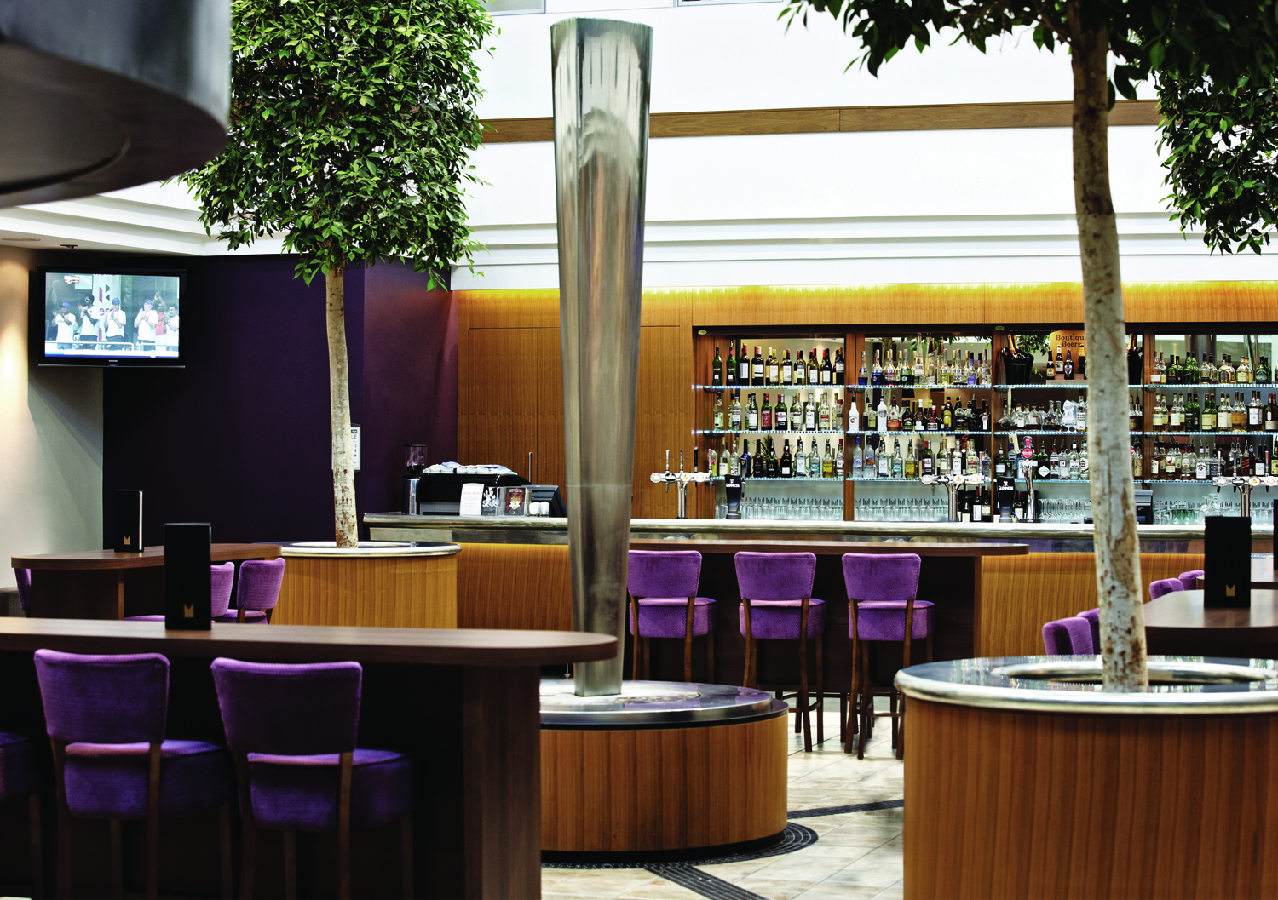
Millennium Madejski Hotel Reading | Food & Beverage
Atrium Bar- An exciting place to meet colleagues or relax and enjoy bar snacks and drinks served until late.
Le Café - An informal dining experience open for breakfast, lunch and dinner with semi private area for groups.
Cilantro Restaurant - Our award winning, fine dining restaurant
Atrium Bar

Slide 10
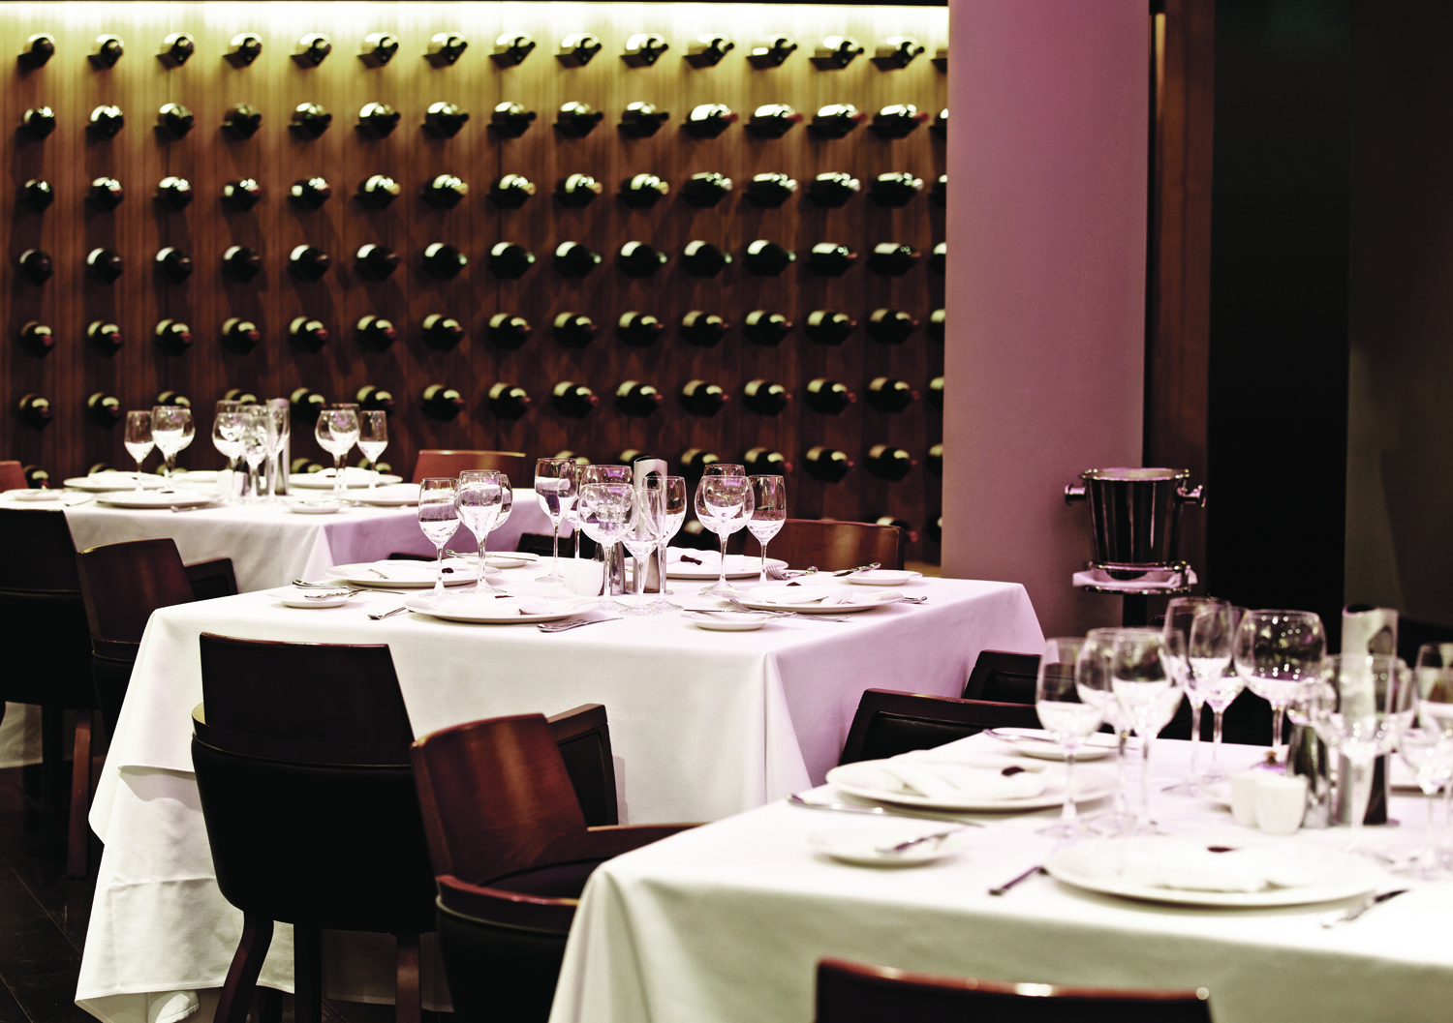
Millennium Madejski Hotel Reading
Cilantro Restaurant

Slide 11
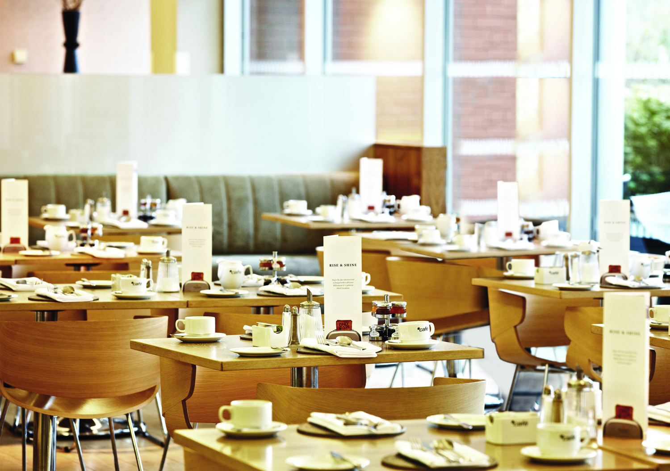
Millennium Madejski Hotel Reading
Le Café Restaurant

Slide 12
Millennium Madejski Hotel Reading | Meetings & Events
The Millennium Madejski Hotel is fully integrated with the Royal Berkshire Conference Centre (RBCC) and Madejski Stadium offering modern flexible meeting and event space
Overview of facilities
Facilities for up to 500 delegates theatre style
42 meeting room throughout the complex
Flexible meeting room set-up options available whether it is a boardroom for 2 or cabaret for up to 360 delegates

Slide 13
Millennium Madejski Hotel Reading & Royal Berkshire Conference Centre | Capacity Chart
 | Theatre | Classroom | Boardroom | Reception | Banquet | U Shape
Madejski | - | - | 14 | - | - | -
Kendrick | 30 | 12 | 13 | - | - | 16
Abbey | 30 | 12 | 13 | - | - | 16
Kendrick & Abbey | 66 | 36 | 24 | 80 | - | 30
*Princess Suite | 500 | - | - | 600 | 400 | -
*Royals, 1871 Suite & Premier Suite | 100 + | - | 30 + | 150 | 100 | 40
*Loddon | 70 | - | 25 | 90 | 70 | 20
*Executive Boxes | - | - | 10 | - | 10 | -
* Denotes meeting rooms within the RBCC

Slide 14
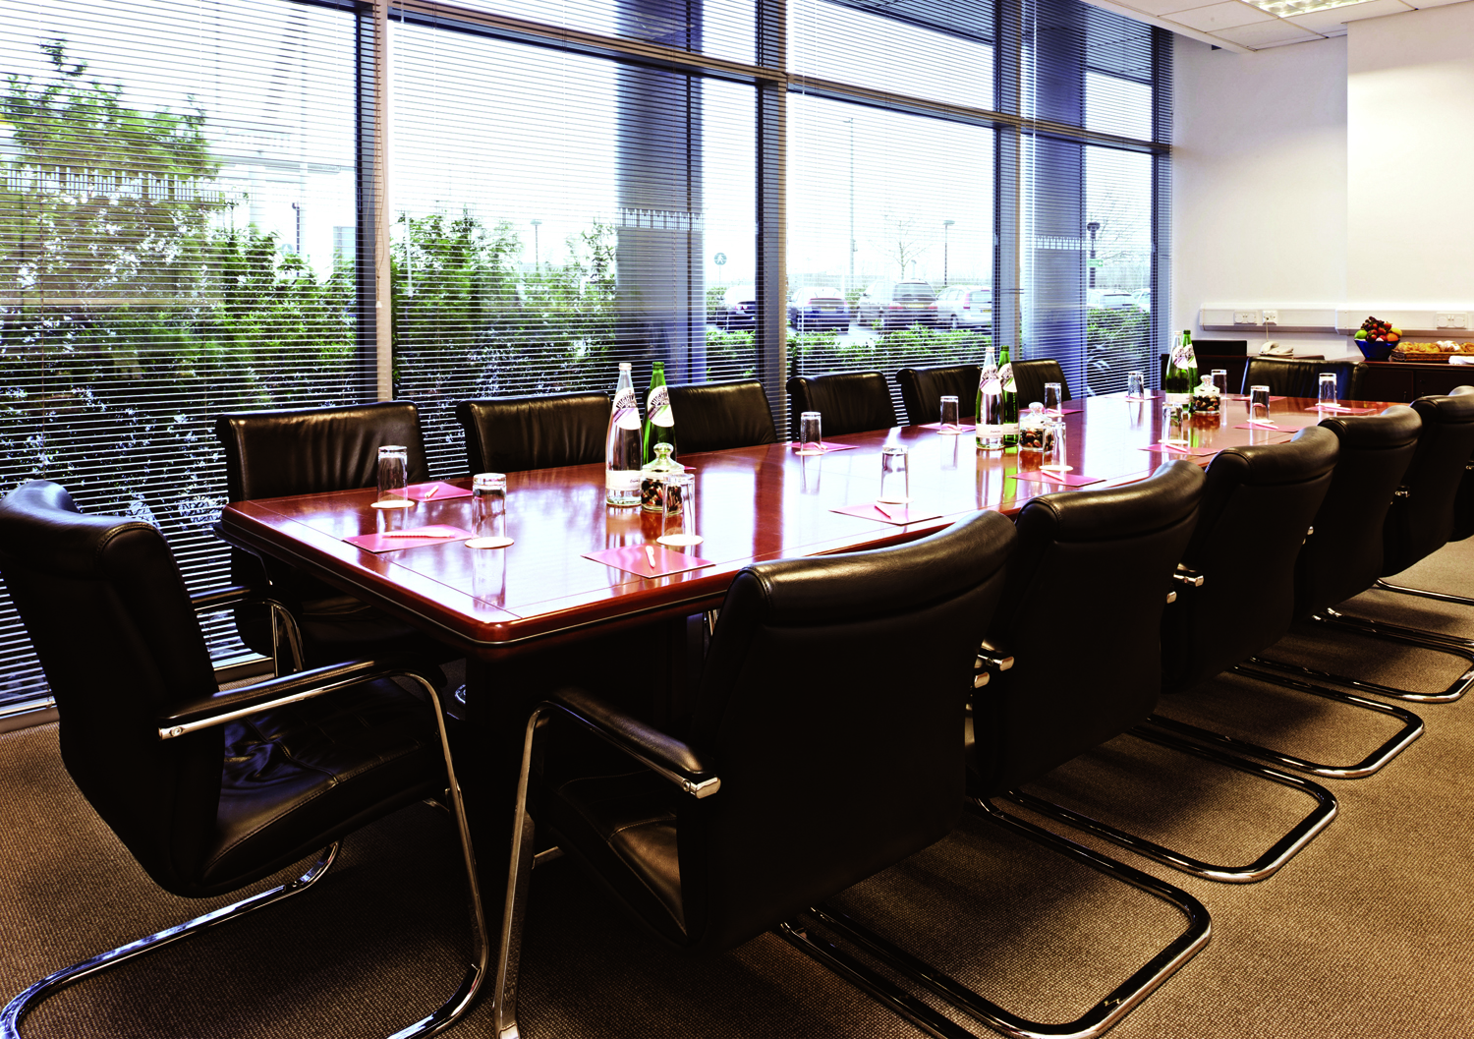
Millennium Madejski Hotel Reading
Madejski Suite

Slide 15
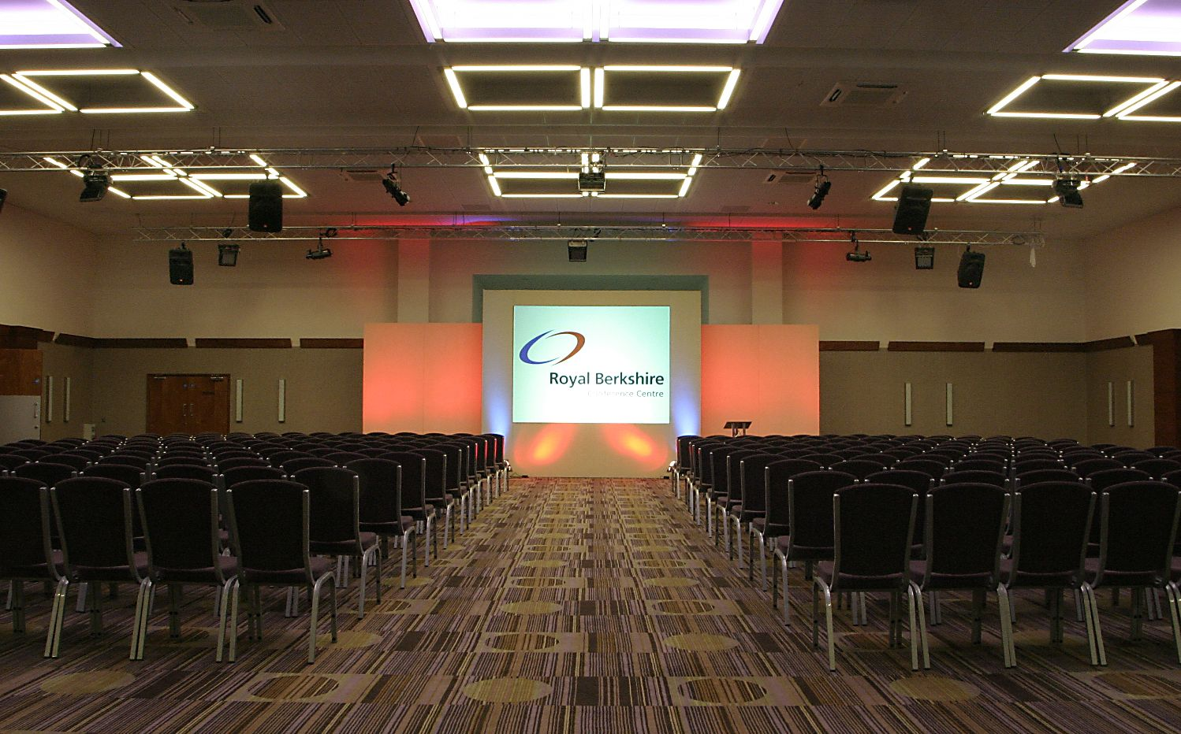
Royal Berkshire Conference Centre
The Princess Suite
Royal Berkshire Conference Centre

Slide 16
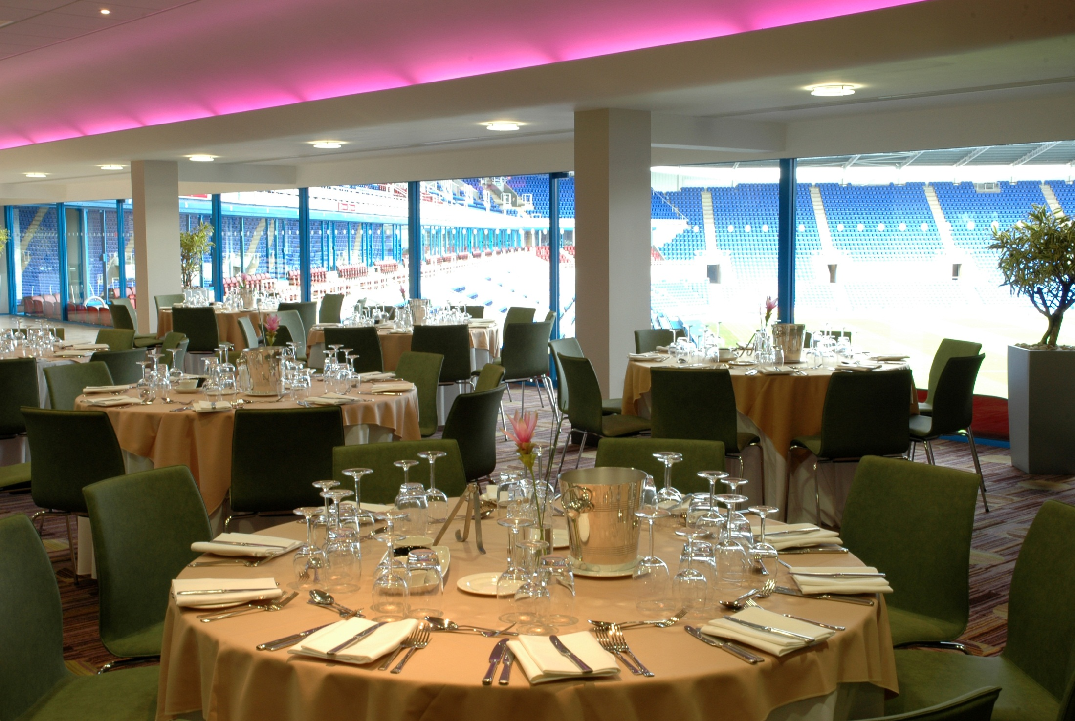
Royal Berkshire Conference Centre
Premier Lounge
Royal Berkshire Conference Centre

Slide 17
Questions?

Slide 18
Business Direct
Business Direct is a programme designed to offer special rates for companies with less than 50 room nights at any Millennium or Copthorne hotel
As a member of Business Direct you are entitled to the following:
10 - 15% off our ‘Best Available’ room rates
Partner stays for free (on a room only basis)
Complimentary newspaper
Monthly newsletter with exclusive special offers
and competitions
Membership to our M&C Loyalty Club where
you can earn points towards complimentary stays
and lifestyle rewards.
To sign up visit: www.millenniumhotels.co.uk/businessdirect

Slide 19
Conference Club
Conference Club is our rewards programme created especially for meetings and conferences agents, we believe you deserve more than just a ‘thank you’.
Programme Overview
Earn 1 point for every £100 worth of Meetings & Events business booked
Each point is worth £2 of Millennium & Copthorne Hotel vouchers or £1 worth of Marks & Spencer vouchers
To sign up visit: www.millenniumhotels.co.uk/conferenceclub

Slide 20
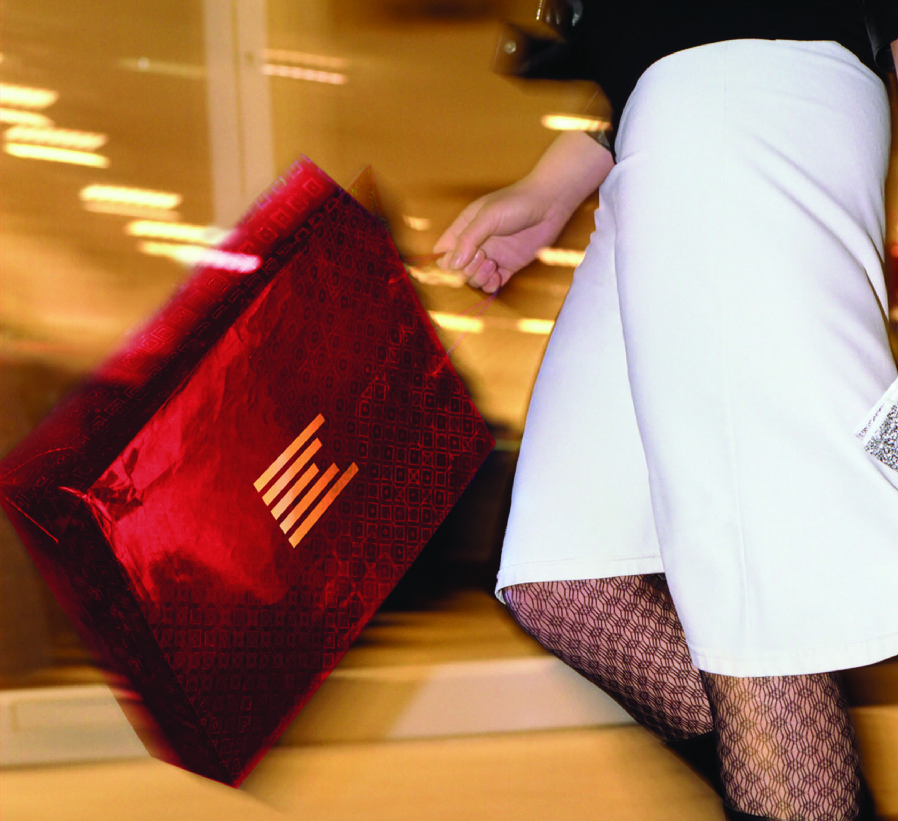
Millennium Rewards
Millennium Rewards is our rewards programme created for secretaries & PAs booking on behalf a company and offers you the opportunity to earn points at hotels across the UK & Europe.
Programme Overview
Earn 1 point for every room night or £100 of meetings & events business booked at our hotels in Europe
Each point can be redeemed for £4 worth of
M & C vouchers or £2 worth of Marks & Spencer vouchers
For more information visit: www.millenniumhotels.co.uk/millenniumrewards

Slide 21
M & C Loyalty Club : Guest Loyalty Programme
Discover the world of hospitality with the M & C Loyalty Club. Each qualifying hotel stay will earn you points that can be redeemed for a wide range of rewards.
Some of the benefits include:
Classic Membership
Entry level of membership
Points earned can be used on a range of rewards from dining and spa vouchers to complimentary stays
Gold Membership
Early check-in / late check-out
Fast track registration
Broadband benefits
20% off our weekend breaks for your birthday
Up to 2 complimentary room upgrades
Diamond Membership
All the benefits of the gold membership
20 % off F & B
Up to 4 complimentary room upgrades

Slide 22
Key Contacts
Ruraigh Whitehead
General Manager
ruraigh.whitehead@millenniumhotels.co.uk
01189 253500
Gerry Skerritt
Director of Sales
gerry.skerritt@millenniumhotels.co.uk
01189 253810
Stefanie Windal
Revenue Manager
stefanie.windal@millenniumhotels.co.uk
01189 253813
Jenny Sparks
Meeting & Special Events Manager
Jenny.sparks@millenniumhotels.co.uk
01189 253813

